Slide 1
INTRODUCTION
TO
DATA MANAGEMENT
(INT217)
Lecture #0

Slide 2
Course Overview
L T P :
Reference Books:
PROFESSIONAL MICROSOFT SQL SERVER 2014 INTEGRATION SERVICES by BRIAN KNIGHT, DEVIN KNIGHT, JESSICA M. MOSS, MIKE DAVIS, CHRIS ROCK, WILEY
FUNDAMENTALS OF BUSINESS ANALYTICS by R.N. PRASAD, SEEMA ACHARYA, WILEY
EXCEL 2016 ALL-IN-ONE FOR DUMMIES by GREG HARVEY, WILEY
EXCEL HACKS,2/ED TIPS & TOOLS FOR STREAMLINING YOUR SPREADSHEETS by DAVID, SHROFF/O'REILLY
2 | 0 | 2

Slide 3
Marks Breakup
Credits : 3
Marks Breakup:
* 2 Best CA out of 3 CA each of 30 marks
* No MTE
Activity | Marks
Attendance | 5
Continuous Assessment | 45
End-Term Practical (ETP) | 50
Total | 100

Slide 4
CA for this course
CA1 : BYOD PRACTICAL
CA2 : BYOD PRACTICAL
CA3 : Project (20 marks project+viva,10marks-(student will upload video on LinkedIn and marks are based upon maximum likes, share and comments)
[ Work on at least 5 objectives, create a dashboard and report ]
Best 2 out of 3 will be counted.

Slide 5
Project Detail (10 Marks Distribution)
Marks | 4 | 3 | 2 | 1
Likes (4) | 200 | 150 | 100 | 50
Share (3) | NA | 20 | 15 | 10
Comment (3) | NA | 20 | 15 | 10

Slide 6

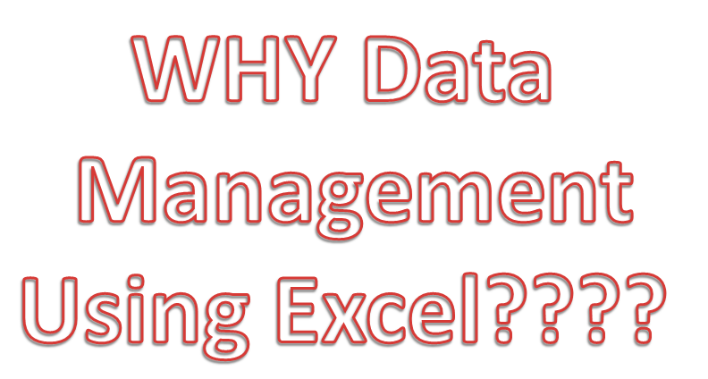

Slide 7
Data Management using Excel
The use of Excel is widespread in the industry. It is a very powerful data analysis tool and almost all big and small businesses use Excel in their day to day functioning. This is an introductory course in the use of Excel and is designed to give you a working knowledge of Excel with the aim of getting to use it for more advance topics in Business Statistics later.

Slide 8
…ctd
The course is designed keeping in mind two kinds of learners –
Those who have very little functional knowledge of Excel and
Those who use Excel regularly but at a peripheral level and wish to enhance their skills.
The course takes you from basic operations such as:
reading data into excel using various data formats
organizing and manipulating data
to some of the more advanced functionality of Excel
All along, Excel functionality is introduced using easy to understand examples which are demonstrated in a way that learners can become comfortable in understanding and applying them.

Slide 9

Revised Bloom’s Taxonomy

Slide 10
Course Outcomes
CO1 :: apply the various techniques and functions over spreadsheet for getting various insights of data
CO2 :: practice the data representation methods like pivot table and power pivoting
CO3 :: determining the need of the graphical representation in the spreadsheet by using various graphs and charts
CO4 :: apply various techniques to validate data in the spreadsheet and perform what-if analysis
CO5 :: employ the power of macros to automate and optimize spreadsheets
CO6 :: extend the concepts of creating interactive dashboards using slicers, macros and advanced charts

Slide 11
Program Outcomes
PO1
Engineering Knowledge:: Apply the knowledge of mathematics, science, engineering fundamentals, and an engineering specialization to the solution of complex engineering problems.
PO2
Problem Analysis:: Identify, formulate, research literature, and analyze complex engineering problems reaching substantiated conclusions using first principles of mathematics, natural sciences, and engineering sciences.
PO3
Design/development of solutions:: Design solutions for complex engineering problems and design system components or processes that meet the specified needs with appropriate consideration for the public health and safety, and the cultural, societal, and environmental considerations.
PO4
Conduct investigations of complex problems:: Use research-based knowledge and research methods including design of experiments, analysis and interpretation of data, and synthesis of the information to provide valid conclusions.

Slide 12
Program Outcomes
PO5
Modern tool usage:: Create, select, and apply appropriate techniques, resources, and modern engineering and IT tools including prediction and modeling to complex engineering activities with an understanding of the limitations.
PO6
The engineer and society:: Apply reasoning informed by the contextual knowledge to assess societal, health, safety, legal and cultural issues and the consequent responsibilities relevant to the professional engineering practice.
PO7
Environment and sustainability:: Understand the impact of the professional engineering solutions in societal and environmental contexts, and demonstrate the knowledge of, and need for sustainable development.
PO8
Ethics:: Apply ethical principles and commit to professional ethics and responsibilities and norms of the engineering practice.
PO9
Individual and team work:: Function effectively as an individual, and as a member or leader in diverse teams, and in multidisciplinary settings.

Slide 13
Program Outcomes
PO10
Communication:: Communicate effectively on complex engineering activities with the engineering community and with society at large, such as, being able to comprehend and write effective reports and design documentation, make effective presentations, and give and receive clear instructions.
PO11
Project management and finance:: Demonstrate knowledge and understanding of the engineering, management principles and apply the same to one’s own work, as a member or a leader in a team, manage projects efficiently in respective disciplines and multidisciplinary environments after consideration of economic and financial factors.
PO12
Life-long learning:: Recognize the need for, and have the preparation and ability to engage in independent and life-long learning in the broadest context of technological change.
PO13
Competitive Skills:: Ability to compete in national and international technical events and building the competitive spirit along with having a good digital footprint.

Slide 14
Content of Course

Slide 15
Unit 1
Spreadsheet functions to organize data : cell reference styles, creating and working with formulas, text functions, date and time functions, lookup and reference functions, mathematical and statistical functions, information and volatile functions, logical and financial functions, formula auditing, error handling, string functions
Introduction to Microsoft Excel : UI Basics : introduction to UI basics, about excel, workbooks and worksheets, customizing excel, reference styles, number formatting, custom number formatting,
conditional formatting, format as table

Slide 16
Unit 2
Data representation and manipulation : filter, advanced filter for complex criterion, sorting and custom sorting, pivot table and pivot chart, power pivot, import data from different sources into power pivot, reducing file size in power pivoting, connect to multiple different external datasets, DAX functions

Slide 17
Unit 3
Advanced graphing and charting : charts, combo charts, working with objects charts, dynamic charts and dynamic data source for charts print areas, views for a worksheet, various printing techniques
Data protection techniques : worksheet protection, protect specific range, workbook protection and encryption

Slide 18
Unit 4
What-if analysis : Goal Seeker, Scenario Manager, Data Table
Data Validation : Understanding the need for Data Validation, creating a Validation List, adding Custom Validation Error, Dynamic Formulas by using Validation Techniques

Slide 19
Unit 5
Macros : Understanding Excel Macros, Activating the Developer Tab in Excel, creating a Macro with
the Macro Recorder, editing a Macro with VBA, creating Buttons to Run Macros

Slide 20
Unit 6
Creating an interactive dashboard : Principles of Dashboarding, mastering charting techniques, Macros for interactive dashboard, Visualizations with Sparklines and Shapes, specialized charts – Waterfall chart, funnel chart, adding maps on dashboard, adding slicers and timelines, connecting slicers with multiple pivot tables, adding hyperlinks to navigate between different sheets

Slide 21
MOOCs
1. Data Visualization in Excel
https://www.coursera.org/learn/excel-data-visualization
2. Create Charts and Dashboards Using Microsoft Excel
https://www.coursera.org/projects/create-charts-dashboards-using-microsoft-excel
3. Excel Basics for Data Analysis
https://www.coursera.org/learn/excel-basics-data-analysis-ibm
4. Excel Skills for Data Analytics and Visualization Specialization https://www.coursera.org/specializations/excel-data-analytics-visualization
5. Excel Skills for Business Specialization
https://www.coursera.org/specializations/excel

Slide 22
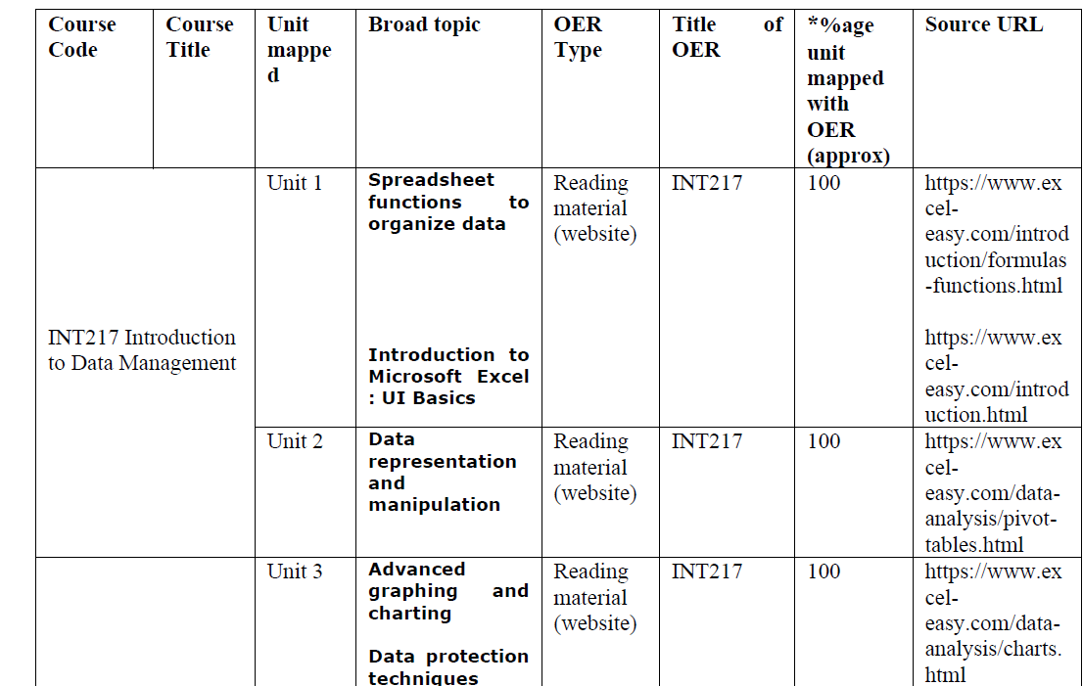
OER

Slide 23
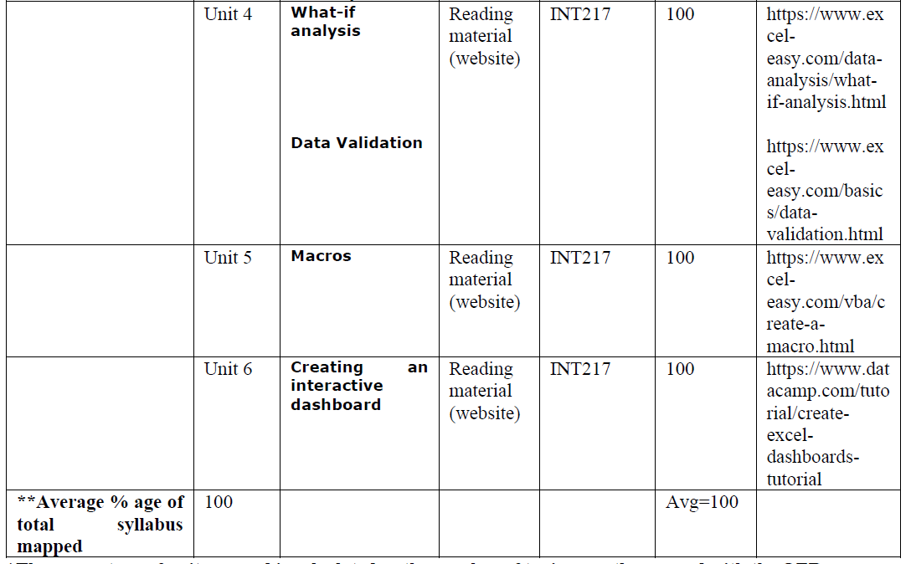

Slide 24
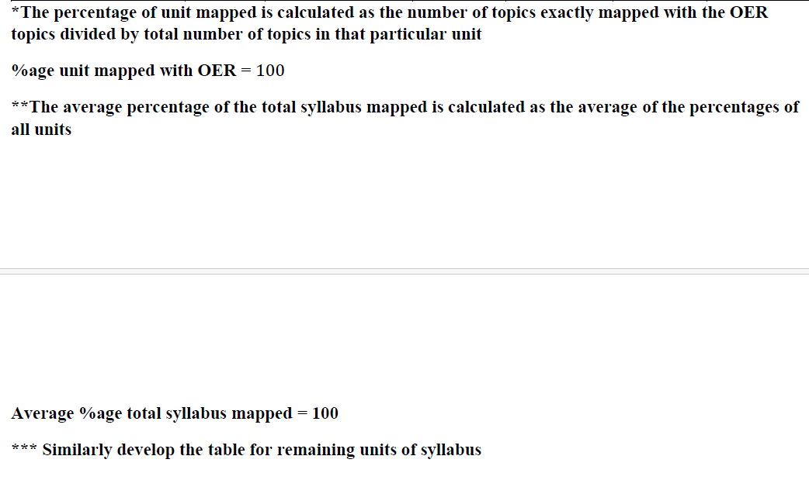

Slide 25
Learning Outcomes
Apply the various techniques and functions over spreadsheet for getting various insides of data
Understand the data representation methods like pivot table and power pivoting
Understand the need of the graphical representation in the spreadsheet by using various graphs and charts
Learn What-if analysis and Data Validation
Advanced Excel skills like Macros
Dashboarding skills using advanced chart, slicers, hyperlinks etcetera

Slide 26



